Slide 1


Culture
[Professor Name]
[Class and Section Number]
Notes:
Classroom Recommendations: This material could be covered in one 75-minute class period. If you are teaching in 50-minute class periods, you will either need to reduce the number of activities and discussion questions or split the information into two class periods. Please refer to the Lecture Framework in the Noba Instructor Manual for specific details.
Overview: The culture module introduces students to basic definitions, concepts, cultural research, and culture as a social process. This PowerPoint presentation provides material, which includes content, activities, and a video. Culture is more than food, dress, and religion. It is the shared learning of a group of people that is transmitted from one generation to the next. Viewed this way, culture is a psychological rather than a material phenomenon. In this module, readers will explore a variety of ways to understand what culture is and how it influences us. Perhaps most importantly, readers will be challenged to develop cultural intelligence: using knowledge about culture to promote self-awareness, increase the quality of intercultural dialogue and to preserve valuable cultural traditions.
Technical Note: These slides may contain simple click animation so that you can focus students’ attention on a particular question, a selection of text, or an image and not have them be distracted by reading ahead. You can either preview the sequence of animation by going through the slides in slideshow view, visiting the animations tab, or reviewing the slide notes. In the notes you will see a cue - (Click) – that corresponds to each animation.
You may also find hyperlinks to outside videos at various places in the slides. These hyperlinks are embedded in text and indicated by color and in the notes section.

Slide 2
Learning Objectives
1. Appreciate culture as an evolutionary adaptation common to all humans.
2. Understand cultural processes as variable patterns rather than as fixed scripts.
3. Understand the difference between cultural and cross-cultural research methods.
Notes:
This slide outlines the learning objectives of the module.

Slide 3
Learning Objectives
4. Appreciate cultural awareness as a source of personal well-being, social responsibility, and social harmony.
5. Explain the difference between individualism and collectivism.
6. Define “self-construal” and provide a real life example.
Notes:
This slide outlines the learning objectives of the module.

Slide 4
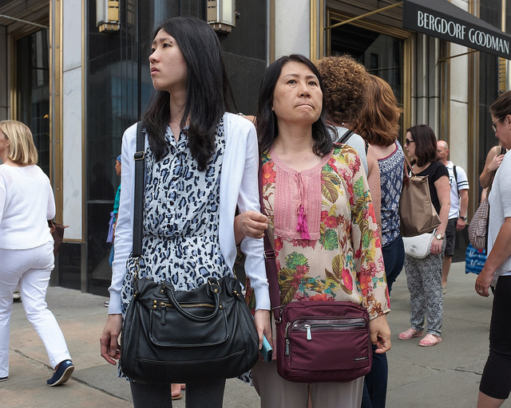
Warmup Activity: Consider Your Culture
Imagine this country through the eyes of a foreign tourist.
What might they notice in this city that would be different from where they live?
Notes:
The purpose of this slide is to facilitate an activity to get students thinking about the concept of culture. The purpose of this activity is to get students to think broadly about culture. Begin by having them reflect silently and write down notes on a piece of paper. Alternately, they can work in small groups.
(Click): Imagine this country through the eyes of a foreign tourist.
(Click): What might they notice in this city that would be different from where they live?
Discussion should then shift to the larger class so that students can share their ideas. Student ideas might include:
-- Physical objects (eg. money, architecture, flags, climate, plants)
-- Visible social differences (eg. dress, cuisine, religion, language)
-- Norms (eg. etiquette, common greetings, driving habits)
-- Other
Note: During the large class discussion try to highlight the wide range of ways that people think about culture. This is one of the main take-home messages from this unit: culture is more than physical artifacts; it is also psychological and affects our identity, feelings, and behavior.

Slide 5
Overview
What is Culture?
Definitions
Aspects
Studying Culture
The Self and Culture
Culture is Learned
Cultural Relativism
Notes:
The purpose of this slide is to provide students with an overview of the material that will be covered during the lecture.

Slide 6
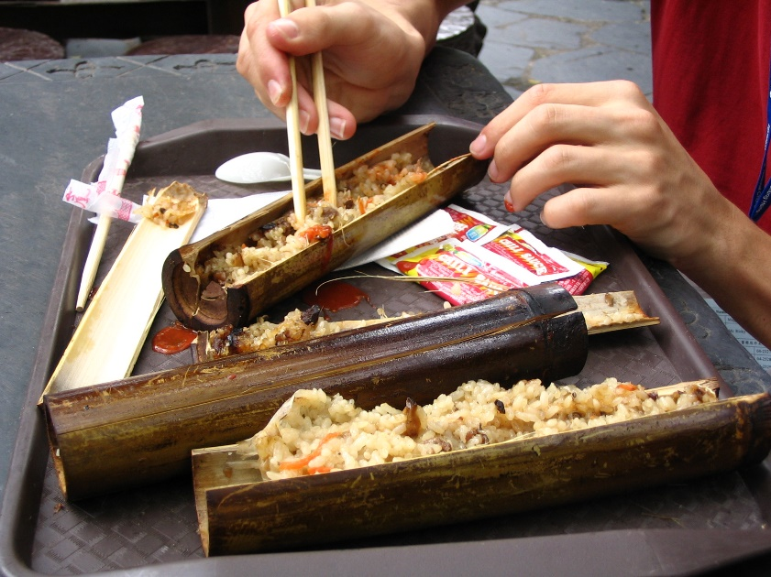
What is Culture? Definitions
Culture: A pattern of shared meaning and behavior
Cultural Intelligence: The ability and willingness to apply cultural awareness to practical uses
Notes:
In this slide the instructor can introduce two key pieces of vocabulary. To help students understand the definition of culture you may want to illustrate concepts such as “pattern” “shared meaning” and “passing from one generation to the next” with examples from the warm up activity.
(Click): Culture: A pattern of shared meaning and behavior among a group of people that is passed from one generation to the next.
(Click): Cultural Intelligence: The ability and willingness to apply cultural awareness to practical uses.
Discussion prompt: Ask for examples of cultural intelligence. Possible answers might include: diplomacy between nations, helping immigrants assimilate into a new society, understanding the international news better, making friends who are culturally different. Consider asking for personal experiences.

Slide 7
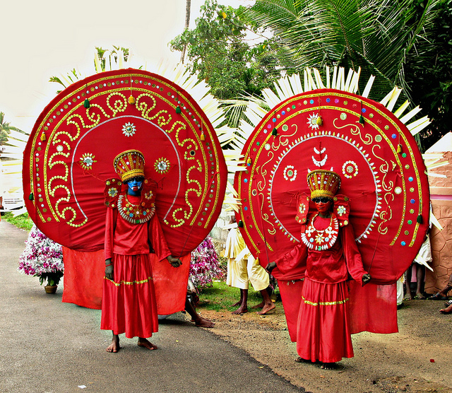
What is Culture? Aspects
Versatile
Shared
Cumulative
Patterns
Notes:
Here, the instructor introduces the idea that culture is not a fixed script. Instead, it is variable. The 4 aspects of culture can highlight this point:
(Click): Versatile– Cultural identity is situational. This means that people’s sense of self is fluid, and shifts depending on the social context. A woman might identify as Canadian while traveling in China, as French speaking while traveling in France, and as Quebecois while traveling in Vancouver.
(Click): Shared— Culture is a concept that exists between people. It is a flexible system of guidelines about how to behave and understandings of how the world works. This means, to some extent, that each individual “owns” the culture of which he or she is a part and influences it.
(Click): Cumulative— Culture is “built” across generations. It incorporates past learning and understandings and develops these continually.
(Click): Patterns— Again, culture is not fixed. The rules are not hard and fast. Rather, they are guidelines and norms that are suggestive of how to think, feel and behave.
Discussion: It is possible to make these abstract ideas come alive for students by facilitating a discussion “youth culture” or “student culture.” The goal here is to engage students in reflection around their own cultural identities, around their own norms, and how these norms change over time and across groups. You might consider using specific examples of norms such as the etiquette (wearing hats indoors, using mobile phones, the use of casual language with strangers, etc) or shared identity (how does a student at a particular high school, college, or university come to feel as sense of belonging there? What is does it mean to be a student there, as opposed to somewhere else? How does this process happen?).
Note about the photo: This photo depicts are ritual known as the Theyyam, for more information, please go to: https://en.wikipedia.org/wiki/Theyyam

Slide 8
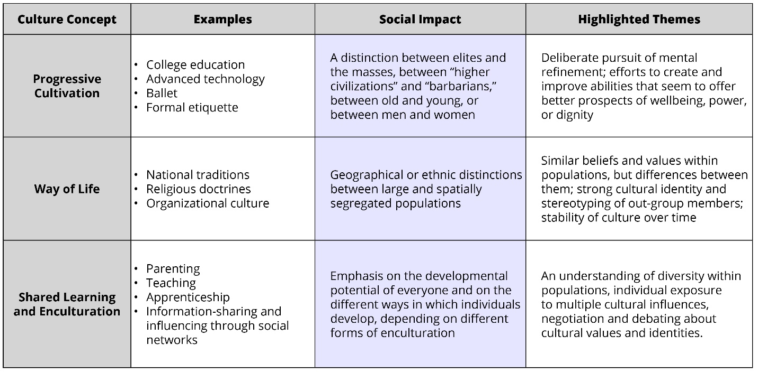
3 common ways to think about culture
Notes:
Here, instructors can further explain the definition of culture by discussing 3 distinct ways by which culture is commonly understood: as progressive, as a way of life, and as shared learning.
Progressive Cultivation: This is the idea of “high culture” and is a concept rooted in social class. That culture is a peak product of civilized societies and an individual who is “cultured” is one who has cultivated musical or art skills or is formally educated. This view has led to prejudicial views against traditional and tribal societies.
Way of Life: This common way of understanding culture preferences the most visible aspects of culture– food, dress, religion, architecture, etc. This is, perhaps, the way that your students are most likely to think of culture.
Shared Learning: This is, perhaps, the least obvious and most psychological approach to thinking about culture. That culture is learned and that it includes many “invisible” concepts such as norms for feeling and expressing emotion, formal rules for language use, sense of identity, and values, among other things.

Slide 9
Overview
What is Culture?
Definitions
Aspects
Studying Culture
The Self and Culture
Culture is Learned
Cultural Relativism
Notes:
The purpose of this slide is to provide students with an overview of the material that will be covered during the lecture.

Slide 10
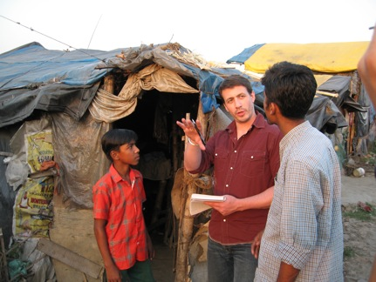
Studying Culture
Culture is a topic of research
Notes:
Here, instructors highlight the fact that culture is a topic of research. As a science, social psychology is principally interested with creating accurate and reliable ways of measuring cultural phenomena. Depending on the class it may be an opportunity to review basic concepts in research methods. It is also an opportunity to invite students to offer their own views on how research might be conducted across cultures.
--Have students ever taken courses in anthropology or sociology?
-- What did they learn about research methods in those courses?
-- Have they ever participated in attitude surveys or similar research?
-- What ideas or stereotypes do they have about researchers in general? Researchers who study culture specifically?
Note: This is an opportunity to stress that these topics are viewed as values-neutral, exploratory topics rather than political in nature. Some students will see cultural differences as a fundamentally political idea (eg. Is it racist or insensitive to draw similarities between Chinese and Japanese people?).

Slide 11
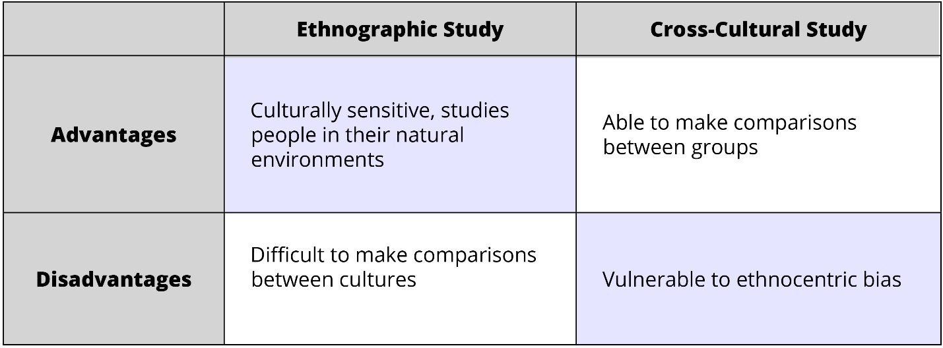
Studying Culture
Cultural versus Cross-cultural Psychology
Notes:
Here, instructors introduce the concepts of cultural and cross-cultural psychology. Because of the similarities of the names this can be a confusing distinction. Cultural psychology is an approach to researching culture that emphasizes an “inside” approach. It relies on interviews, observation, and the cultural members’ own language to define and explain important concepts and behaviors. By contrast, cross-cultural psychology is an approach to researching culture that emphasizes the use of standard measures and scales to allow for easier comparisons between cultures.
Related concepts:
Ethnographic Studies
Anthropology
Activity: You can engage students in small group activity in which they critically evaluate these research methods. Prompt them to consider themselves researchers who want to investigate the cultural phenomenon of what it is like to live in a very small town. They are interested in how small town culture is similar to or different from that of big city culture. Which of these approaches to studying culture might they use? How might they protect against disadvantages associated with their method?

Slide 12
Overview
What is Culture?
Definitions
Aspects
Studying Culture
The Self and Culture
Culture is Learned
Cultural Relativism
Notes:
The purpose of this slide is to provide students with an overview of the material that will be covered during the lecture.

Slide 13
The Self and Culture
INDIVDIUALISM | COLLECTIVISM
The self is unique | The self is part of a group
The self is relatively stable across situations | The self is relatively fluid across situations
Personal goals and the opportunity to express one’s self are important | Personal duties and group well-being are important
USA, Canada, Germany | Japan, Korea, Taiwan
Notes:
In this section, instructors introduce the first of two of the most important concepts in the study of psychology and culture: Individualism and Collectivism. Instructor’s Note: The table shown on this slide does not appear in the Noba module on culture, although these concepts are covered in depth.
Individualism/Collectivism– There is a fundamental difference in the way that the basic unit of society is measured and understood across cultures.
Individualism: Individualistic cultures consider the individual the basic unit of measurement. Individuals are considered to be unique and these societies are more likely to celebrate the diversity that comes with uniqueness. The cultural task of the individual is to develop their own uniqueness. Individuals are expected to pursue their own goals and are seen as capable of creating their own happiness. They are free to express their own opinions and take credit for successes. Examples of these cultures include the United States, Canada, Australia and Germany.
Collectivism: Collectivist cultures consider the group to be the basic unit of measurement. Individuals are considered to be group members and these societies are more likely to celebrate group harmony and collective well-being. The cultural task of the individual is to fulfill duties and responsibilities and to preserve group harmony. Individuals are expected to put personal goals aside if they come into conflict with group goals. People are more likely to express humility, to defer to authority, and to withhold their own opinions. Examples of these cultures include South Korea, Taiwan, and Japan.
These two categories can be further sub-divided into “horizontal” (everyone is of equal status) and “vertical” (there is a social hierarchy) dimensions.
Discussion: Both individualism and collectivism have attractive qualities. Students can discuss the elements of each that sound appealing, and explain why. This can be done in a large group, small groups, or in pairs.

Slide 14
The Self and Culture
Independent Self | Interdependent Self
Trait focused | Relationship focused
Traits guide decisions and behavior | Situations guide decisions and behavior
Notes:
In this section, instructors introduce the second of two of the most important concepts in the study of psychology and culture: the Independent self and the Interdependent self. Individualism and Collectivism. Note: The table shown on this slide does not appear in the Noba module on culture, although these concepts are covered in depth.
The Independent self and the Interdependent self are both self-construals; that is, they are ways that people define themselves. People with an independent orientation are likely to see themselves as a collection of stable traits, and these traits guide decisions and behavior. By contrast, people with an interdependent orientation are likely to see themselves as a collection of fluid relationships and it is situations that guide decisions and behavior.

Slide 15

The Self and Culture
The compliments I most frequently receive from others……
Notes:
Activity: Here you want to engage students in a variation of the classic fill in the sentence activity (“I am ……”). In the original version– that is discussed in the Noba text– people with an independent sense of self were likely to list personal traits and those with an interdependent sense of self were likely to list relationships. In this version of the activity students list five compliments they are most likely to receive from others. Again, people with an independent orientation are likely to hear and remember compliments in terms of traits (eg. I am kind, I am athletic, I am empathic) even if these are traits that are used in a social capacity, such as forgiveness. Those with a more interdependent orientation will report more relational or role based compliments (e.g. “I am a good friend” “I am a leader”). It should be noted that some students will report both types and this is okay. This is an opportunity to emphasize that culture is not a hard and fast set of rules but a variable pattern of thinking, feeling and behavior.
It should be noted that some students will report both types and this is okay. This is an opportunity to emphasize that culture is not a hard and fast set of rules but a variable pattern of thinking, feeling and behavior.

Slide 16
Overview
What is Culture?
Definitions
Aspects
Studying Culture
The Self and Culture
Culture is Learned
Cultural Relativism
Notes:
The purpose of this slide is to provide students with an overview of the material that will be covered during the lecture.

Slide 17

Culture is Learned
Identity
Emotions
Etiquette
Values/Morals
Notes:
This slide represents a particularly interesting way for students to engage with the concept of culture. The central thesis behind this portion culture acquisition is the idea that culture is learned. For many students this is an “aha!” insight. Many people have not taken the time to reflect on the fact that many of the thoughts and behaviors that seem so natural to them are, in fact, the products of cultural learning.
Small group discussion: Here, you can divide students into small group. Each can take one of the 4 topics listed on the slide (or you can add topics of your own). Each groups is tasked with:
Generating examples of their theme. For instance, “not wearing a hat indoors” would be an example of etiquette. “Males not wanting to cry in front of others” would be an example of emotion norms. “America is the free-est country on Earth” is an example of an identity norm. “We should celebrate diversity” is an example of value norms.
Next, the group should use these examples as the basis for discussion. Specifically, they are discussing the mechanisms by which these examples have been taught and learned. For instance, some norms are overtly taught, such as a parent who tells a child to say “excuse me.” Other norms are learned through observation such as a small girl who wants to play with make-up. Still others are associated with formal societal institutions and practices such as Public Service Announcements, laws, government policy, religious practices, and so forth.
After a set period of time (about 5 minutes) have the groups come together and share their insights. A possible follow-up discussion question could be “If these things are learned could you change the way you think or behave? How difficult or easy would it be? What would be some of the obstacles?”

Slide 18
Overview
What is culture?
Definitions
Aspects
Studying Culture
The Self and Culture
Culture is Learned
Cultural Relativism
Notes:
The purpose of this slide is to provide students with an overview of the material that will be covered during the lecture.

Slide 19
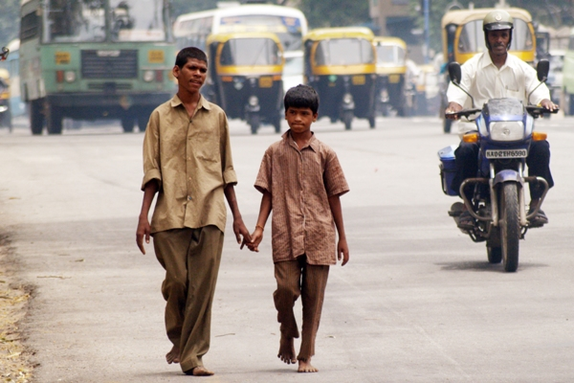
Cultural Relativism
Notes:
This lecture concludes with a discussion of cultural relativism.
Key concepts and definitions:
Cultural relativism: The principled objection to passing overly culture-bound (i.e., “ethnocentric”) judgements on aspects of other cultures.
Ethnocentric bias (also called ethnocentrism): Being unduly guided by the beliefs of the culture you’ve grown up in, especially when this results in a misunderstanding or disparagement of unfamiliar cultures.
Value judgment: An assessment—based on one’s own preferences and priorities—about the basic “goodness” or “badness” of a concept or practice.
Possible Activity: You can have the students debate a cultural practice, while keeping vigilant for ethnocentric biases, value judgments, and the concept of cultural relativism. Debate topics range from the very safe (eg. The pros and cons of driving on the left side of the road, male friends holding hands in India, believing that your college is superior to a rival college) to the more controversial (eg. Female circumcision, women not being allowed to drive in Saudi Arabia, the death penalty). If you are concerned that such a discussion could get too heated, consider randomly assigning students to a for or against position.
The theme to highlight here is the delicate balance between acceptance of other ways of thinking and behaving, and also speaking out against practices that might be harmful.

Slide 20

CAT: One-Minute Paper
What was the most important thing you learned during this class?
What will you do with this information? How will it affect your life?
What important question remains unanswered?
Notes:
Classroom Assessment Technique (CAT): One-Minute Paper
If you are presenting the information on one class day, you might end the material about here. End your class time with a one-minute paper.
The Minute Paper tests how students are gaining knowledge, or not. The instructor ends class by asking students to write a brief response to the following questions: “What was the most important thing you learned during this class?”, What will you do with this information? How will it affect your life? and “What important question remains unanswered?”
Have students briefly answer these questions in writing and turn them in. After class, assess students’ responses. At the beginning of the next class, go over any misunderstandings or relevant questions.
If you do not conclude with this Classroom Assessment Technique (CAT), it would helpful to use another CAT. It could be in the form of a:
Muddy point
One-minute paper
Background knowledge
What’s the Principle?
Defining features Matrix:
For more information on CATs click here: http://cft.vanderbilt.edu/guides-sub-pages/cats/

Slide 21
Photo Attribution
Slide 1 | Photo Credit: 24-08-10 If I Only Could I'd Make A Deal With God Bethan Phillips https://www.flickr.com/photos/beth19/4923647610 https://creativecommons.org/licenses/by-nc-nd/2.0/
Slide 3 | Photo Credit: New York City Street Scenes - Two Japanese Women Tourists Outside Bergdorf Goodman Steven Pisano https://www.flickr.com/photos/45776673@N04/18664041884/ https://creativecommons.org/licenses/by/2.0/
Slide 5 | Photo Credit: Traditional Taiwanese Food M. Weitzel https://commons.wikimedia.org/wiki/File:Traditional_Taiwanese_Food.jpg#/media/File:Traditional_Taiwanese_Food.jpg https://creativecommons.org/licenses/by/2.5/
Slide 6 | Photo Credit: Theyyam.. A Popular Form of Hindu Ritual Art in Kerala... –Reji https://www.flickr.com/photos/rejik/4710797751 https://creativecommons.org/licenses/by-nc-sa/2.0/
Slide 9 | Photo Credit: Studying Culture Robert Biswas-Diener https://creativecommons.org/licenses/by-nc-sa/4.0/
Slide 14 | Photo Credit: Post It Alexas_Fotos https://pixabay.com/en/post-it-fantastic-message-list-861868/ https://creativecommons.org/publicdomain/zero/1.0/deed.en
Slide 16 | Photo Credit: Hi, Everyone! malone545 https://www.flickr.com/photos/8167329@N06/17342475786/ https://creativecommons.org/licenses/by-nc-nd/2.0/
Slide 18 | Photo Credit: Friendship Day Subharnab Majumdar https://www.flickr.com/photos/19364701@N00/40407262/ https://creativecommons.org/licenses/by/2.0/
Slide 19 | Photo Credit: Illustrated silhouette of a black cat nehtaeh79 http://www.freestockphotos.biz/stockphoto/16624 http://creativecommons.org/publicdomain/zero/1.0/
Notes:
Photo Attribution Slide

